Slide 1

Social Engineering Authentication
Gerhard Steinke

Slide 2
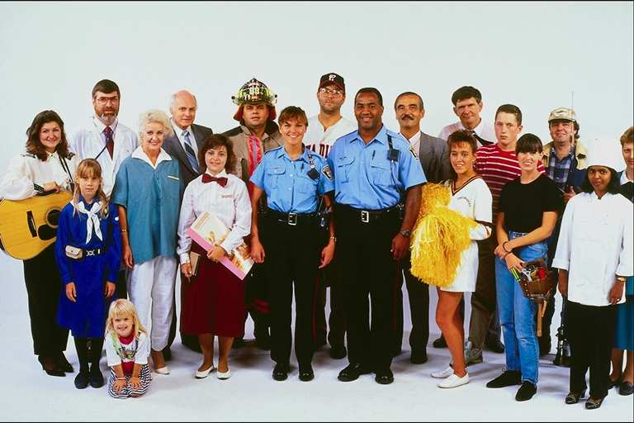
Social Engineering
Can you spot a “Social Engineer” in this group?
“Social Engineering is the acquisition of sensitive information or inappropriate access privileges by an outsider, based upon the building of an inappropriate trust relationship with insiders.”

Slide 3

Goal of Social Engineering
deceive or con others into divulging information that they wouldn’t normally share.
Trick someone into providing valuable information or access to that information.
preys on qualities of human nature:
the desire to be helpful
the tendency to trust people
the fear of getting into trouble

Slide 4
Interactive Techniques
Asking directly
Pretending to be an important user
Acting like a helpless user
Imitating a tech or IT employee
Imitating vendor employee
Janitorial
Equipment vendor

Slide 5
Non-Interactive Techniques
Phishing
Shoulder surfing
Post-it notes
Company directory, website
Dumpster diving

Slide 6
Factors for Success
Trust
Use of the phone
Non-arousal of suspicion
Making person feel useful
Authority
Reciprocation

Slide 7

Preventing Attacks
Clear policy and processes
Balance between suspicion and efficiency/trust
Classification of data
Securing the trash
Background checks
Routine training
Verification, verification, verification

Slide 8
Recognize the Signs
Refusal to give contact information
Rushing
Name-dropping
Intimidation
Small mistakes
Requesting password
Requesting forbidden information
Ask for the correct spelling of their name
Ask for a number where you can return their call
Ask them why they need this information
Ask them who has authorized the request and let them know that you will verify the authorization

Slide 9
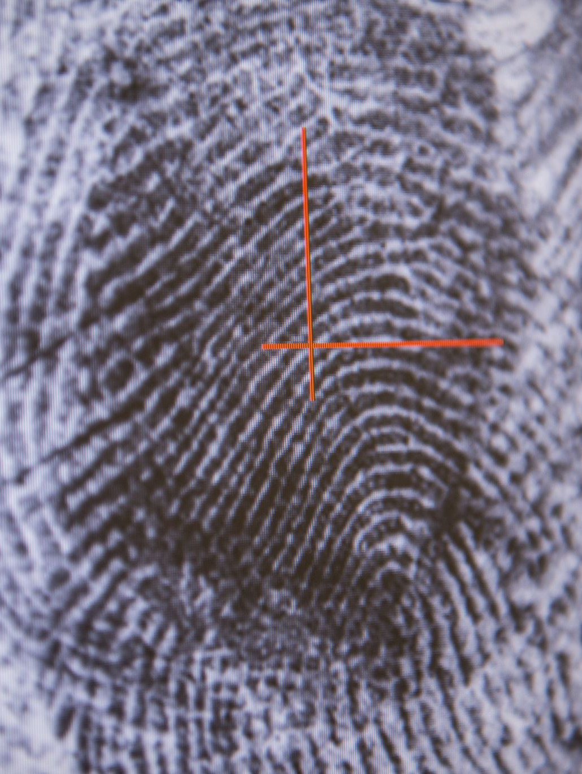
Authentication
Assurance of identity
Proving that the object or the subject is what/who it claims to be

Slide 10
Multi-factor Authentication
Something that you know
password, personal data, secret question
Something that you have
a token, access card
Something that you are
Biometrics, fingerprint, signature
Something that says where you are
Location dependent
IP, Mac address of device

Slide 11
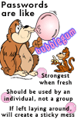
Password Requirements
Length
Content, complexity
Frequency of changing
based on expected time to guess a password
Password aging
Disallow change to previous n passwords
Lockout after n incorrect attempts
Different passwords

Slide 12
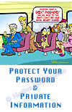
Safeguard Your Strong Password
Be careful about typing your password into a strange computer.
Is the owner trustworthy or are they perhaps running a keyboard logger recording your keystrokes?
Who was the last person to use it and what did they run on it?
System Administrator: Run password-cracking programs to identify those users having easily guessed passwords ?
Authority, Permission to run password cracking programs?

Slide 13
Biometrics
Identify people by measuring some aspect of individual anatomy or physiology, some deeply ingrained skill, or other behavioral characteristic
Handwritten signatures
Face Recognition
Fingerprints
Iris Codes
Voice
Retina Prints
DNA Identification
Palm Prints
Handwriting Analysis
Facial Thermograms
Vein identification
Scent Detection
Gait recognition
Typing (www.typingdna.com)

Slide 14
Errors
All recognition systems are subject to error
‘Fraud’ / ‘false positive’
A client is accepted as authenticated when they should have been rejected
‘Insult’ / ‘false negative’
A client is rejected as NOT authenticated when in fact they should have been accepted.

Slide 15
Accuracy Rates
False Match Rate (FMR)
Single False Match Rate vs. System False Match Rate
If the FMR is 1/10,000 but you have 10,000 templates on file — odds of a match are very high
False Non-match Rate (FNR)
Failure-to-Enroll (FTE) rate
Ability to Verify (ATV) rate:
% of user population that can be verified
ATV = (1-FTE)(1-FNMR)

Slide 16
Biometric Issues
Stability of characteristic over lifetime
Suitability for logical and physical access
Difficulty of usage

Slide 17
Face Recognition
The oldest way
Widespread acceptance (and requirement) for photo ID
The issuing of other authentication devices usually depends on facial recognition by the agents of the issuing authority
Photo-ID is not particularly reliable, but has a very significant deterrent effect

Slide 18
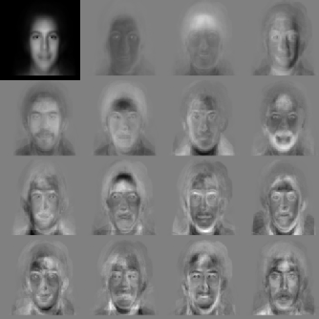
Facial Scan/Recognition
Based on video Images
Templates can be based on previously-recorded images
Notes:
http://www.facial-scan.com/facial-scan_technology.htm - MIT Face Recognition Demo Page

Slide 19
Facial Scan
Strengths:
Database can be built from official (driver’s license records, visas, etc.) or unofficial (social media) sources
Can be applied covertly (surveillance photos).
Few people object to having their photo taken
Weaknesses:
scientific validation?
Attacks:
Surgery
Facial Hair
Hats
Turning away from the camera
Defenses:
Scanning stations with mandated poses

Slide 20
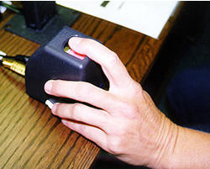
Fingerprints
Accounts for the majority of sales of biometric equipment
The ridges that cover the fingertips make patterns
These patterns have loops of several distinct types, branches, and endpoints. Because of the association with criminals, commercial users are very reluctant to impose fingerprinting systems upon their clients
Fingerprint sensors on laptops, phones

Slide 21
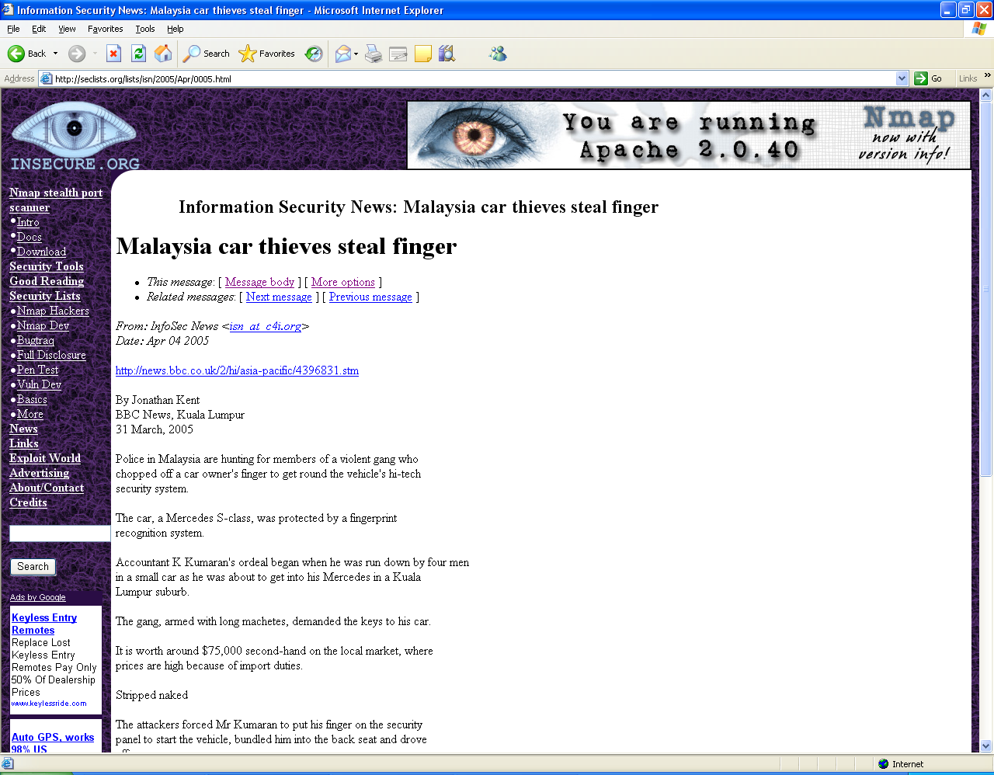

Slide 22
Iris Codes
Iris patterns believed to be unique
The patterns are easy enough to detect
They do not wear out
They are protected by the eyelids and cornea
Easier to capture and process than fingerprints
A processing technique is used to generate a 256 byte iris code
Low false acceptance rates

Slide 23
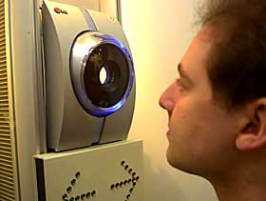
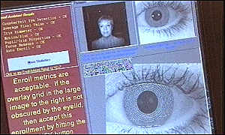
Iris Codes
Practical difficulties:
Capturing the iris image is intrusive
The subject has to be co-operative

Slide 24
Voice Recognition
Strengths:
Most systems have audio hardware
Works over the telephone
Can be done covertly
Lack of negative perception
Weaknesses:
Background noise
No large database of voice samples
Attacks:
Tape recordings
Identical twins / soundalikes

Slide 25
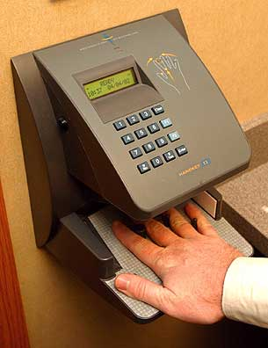
Hand Scan
Typical systems measure 90 different features:
Overall hand and finger width
Distance between joints
Bone structure
Primarily for access control:
Machine rooms
Olympics
Strengths:
No negative connotations – non-intrusive
Reasonably robust systems
Weaknesses:
Accuracy is limited
Notes:
http://www.cjonline.com/images/040502/new.handscan.jpg

Slide 26
Template Size
Biometric | Approx Template Size
Voice | 70k – 80k
Face | 84 bytes – 2k
Signature | 500 bytes – 1000 bytes
Fingerprint | 256 bytes – 1.2k
Hand Geometry | 9 bytes
Iris | 256 bytes – 512 bytes
Retina | 96 bytes

